Slide 1
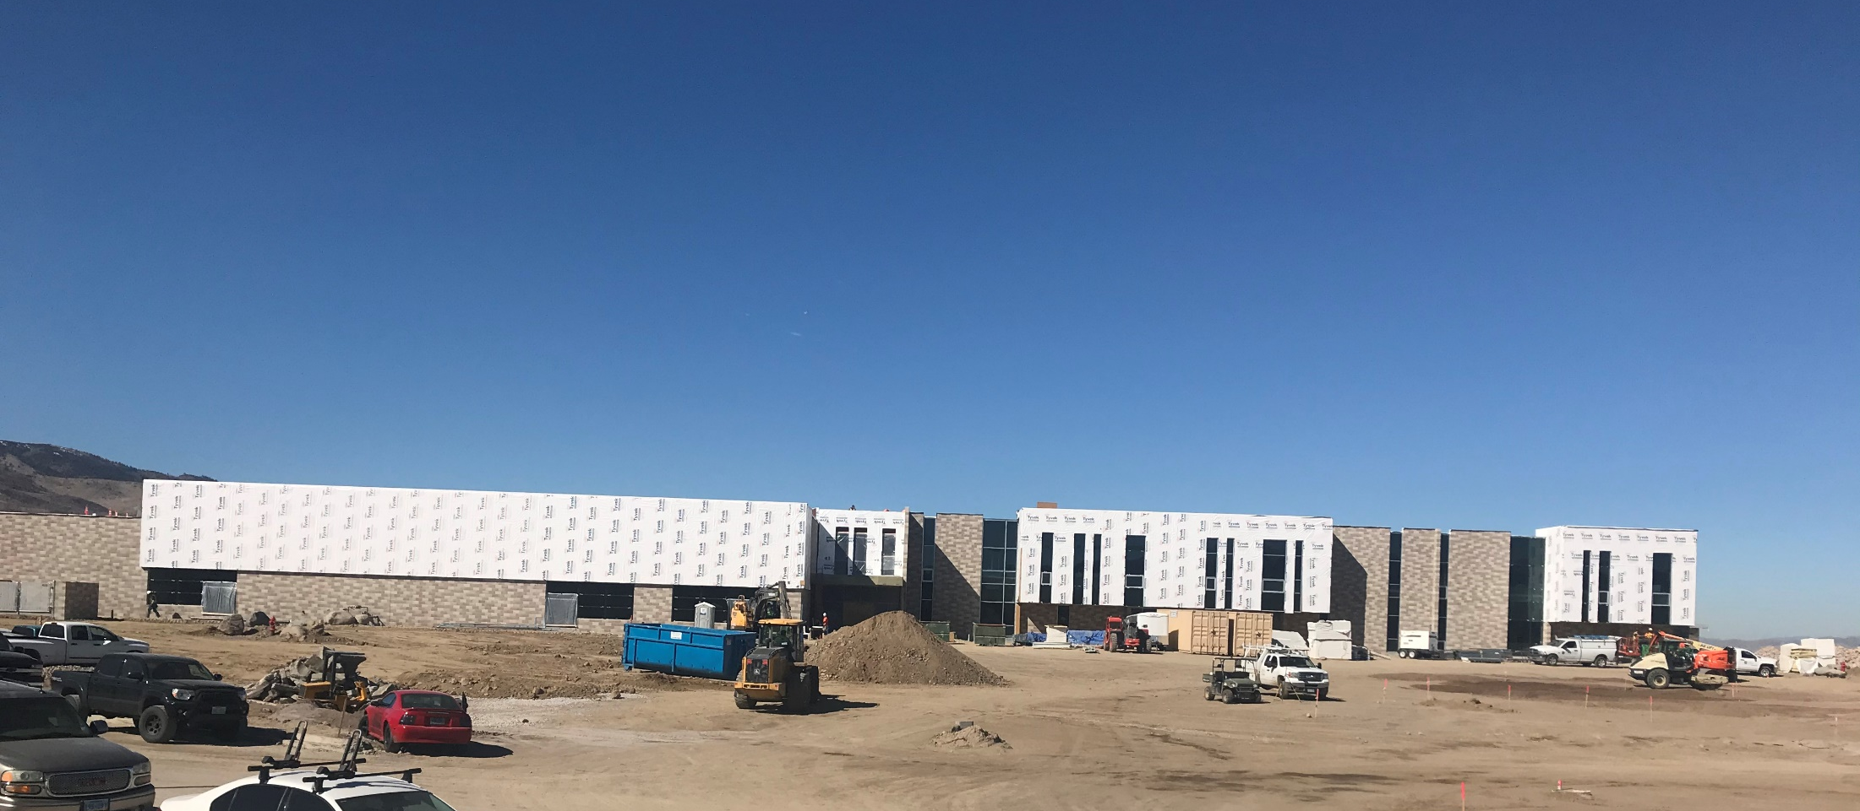
WADMIN20-0003 (Marce Herz Middle School Sign)
Washoe County Board of Adjustment
April 16, 2020

Slide 2
Request
This is a request for an administrative permit to allow for the installation of 253 sq. ft. sign for the new Marce Herz Middle School
Signs greater than 120 square feet are permissible for civic uses within the Low Density Suburban (LDS) regulatory zone subject to approval of an Administrative Permit per Article 505, Sign Regulations

Slide 3
Background
Marce Herz Middle School is a new school that is currently being constructed at 13455 Thomas Creek Road
The site has regulatory zoning of Low Density Suburban (LDS)
A proposed sign with the school name, Marce Herz Middle School will be 253 sq. ft. and located on the gym building
It will be visible from Arrowcreek Parkway
There are other signs being installed at the school however they are not over 120 sq. ft. in size

Slide 4
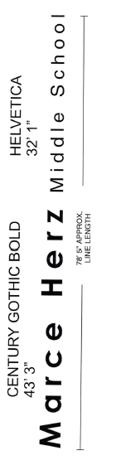

School Name sign

Slide 5
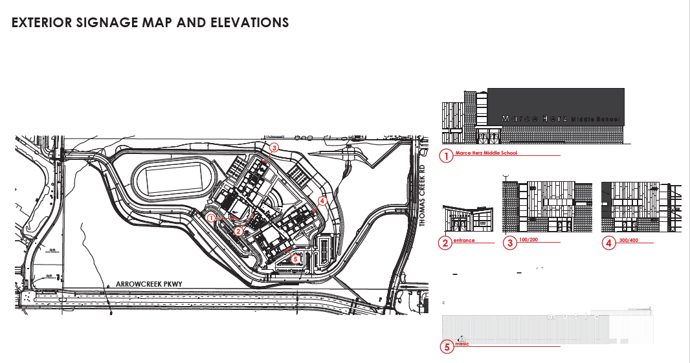
Site Plan

Slide 6
Public Notice and CAB
Public notice was sent to parcels within 500 feet from the site
The South Truckee Meadows/Washoe Valley CAB reviewed the application March 5, 2020 and recommended approval with very little discussion

Slide 7
Reviewing Agencies
Various agencies reviewed the application, their comments are included in the staff report
Agencies with conditions, are included in the Conditions of Approval

Slide 8
Administrative Permit Findings
Consistency;
Improvements;
Site Suitability;
Issuance Not Detrimental; and
Effect on a Military Installation.
Staff is able to make the required findings, as shown in the staff report on page 6 and recommends approval

Slide 9
Possible Motion
I move that, after giving reasoned consideration to the information contained in the staff report and information received during the public hearing, the Board of Adjustment approve Administrative Permit Case Number WADMIN20-0003 for Board of Adjustment, having made all five findings in accordance with Washoe County Development Code Section 110.808.25

